Slide 1
Tailored Nutrition
Cpstn

Slide 2
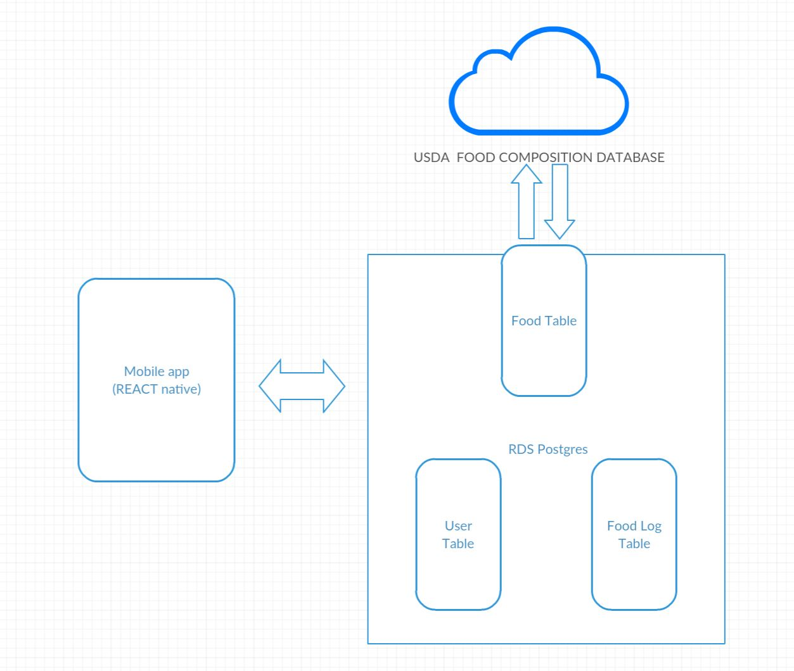
Architecture NEEDS REST API

